Slide 1


PREDICTIVE MODEL AND ITS RESULTS
06-12-2023

Slide 2
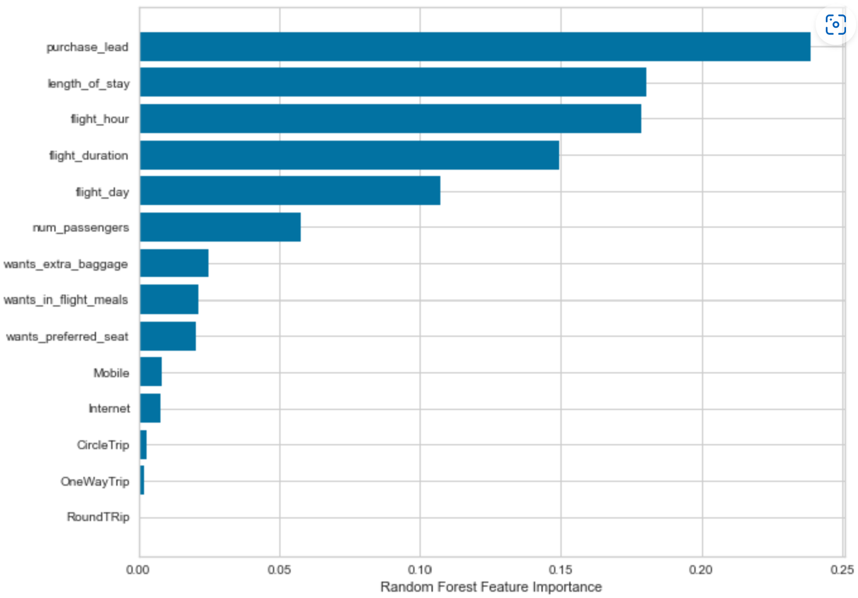
PREDICTIVE MODELLING RESULTS
Recall Rate
60%
Precision
61%
Chance of predicting true successful bookings.
Will be predicted as actually completed bookings out of all successfully completed bookings.
66% Chance of predicting true incomplete bookings correctly.
Accuracy
62%
Accuracy of the model predicting successful or incomplete booking is
We are concerned with not predicting the successful bookings correctly. Imbalance dataset drives higher accuracy but it does not accurately predict the successful bookings. Dataset was balanced with 8k labelled as incomplete bookings and 7k as complete bookings.
Top features that can drive successful flight bookings.

